Slide 1
Phase IV Introduction
Lt(N) Blatch

Slide 2
To provide Petty Officers with the theoretical knowledge and practical experience required to participate in Cadet Corps activities and appointments as a team leader.

Slide 3
Activity
Manager
Activity Leader
Team Leaders
Peer Leaders
Team Members

Slide 4
PO Performance Objective |  | EO Enabling Objective
401 | Recognize How the Legal System Affects Youth | 4 Complimentary
402 | Perform Community Service | 9 Mandatory
403 | Act as a Team Leader | 10 Mandatory
404 | Update Personal Activity Plan | 4 Mandatory
405 | Participate in Recreational Sports | 9 Mandatory
406 | Fire the Cadet Air Rifle During Recreational Marksmanship | 3 Mandatory
407 | Serve in a Sea Cadet Corps | 2 Mandatory
408 | Command A Division | 5 Mandatory
409 | Instruct A Lesson | 10 Mandatory
311 | Participate in a Summer Biathlon | 9 Complimentary
420 | Recognize Aspects of the Royal Canadian Navy | 4 Mandatory
422 | Describe the Required Responses to Changing States of Weather While Operating a Small Craft | 17 Complimentary
423 | Locate a Position on a Chart | 12 Mandatory
424 | Sail a Sailboat IAW CANSail 1 | 1 Weekend

Slide 5
Performance Objective
 | Inter-Divisional Seamanship Competition | 1 Mandatory, 2 Days
 | Positive Social Relation for Youth | 6 Mandatory
 | Annual Ceremonial Review | 3 Mandatory

Slide 6
Act as a Team Leader
Instruct a Lesson

Slide 7
60% Attendance
Complete all POs

Slide 8
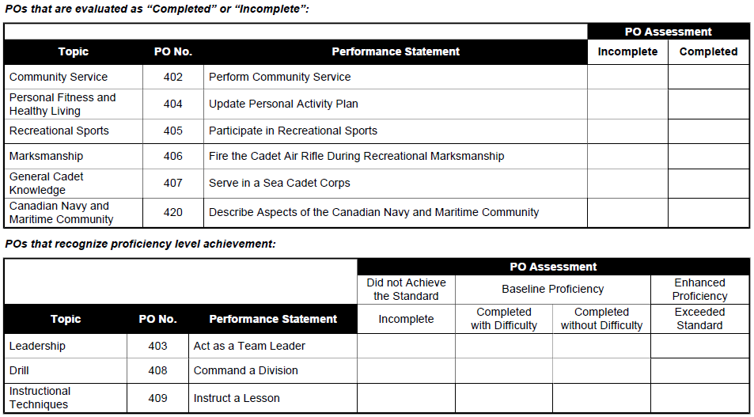

Slide 10
6 Months as PO2
Complete Phase 4
Achieve “Completed without difficulty” in leadership
Participate in the Cadet fitness Assessment
Be Recommend by your Divisional Officer
Commanding Officers approval

Slide 11
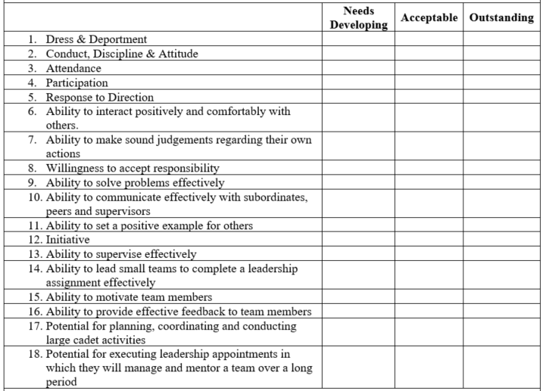

Slide 12
Robin.Blatch@cadets.gc.ca
www.1Nelson.ca/phase-4.html

Slide 13
What a Leader does or does not do is constantly interpreted

